Slide 1



evOps
CI/CD Pipeline
Project
By
Rashad Ahmed
Alaa El-Gebaly
Mohamed Abd el-hamed

Slide 2
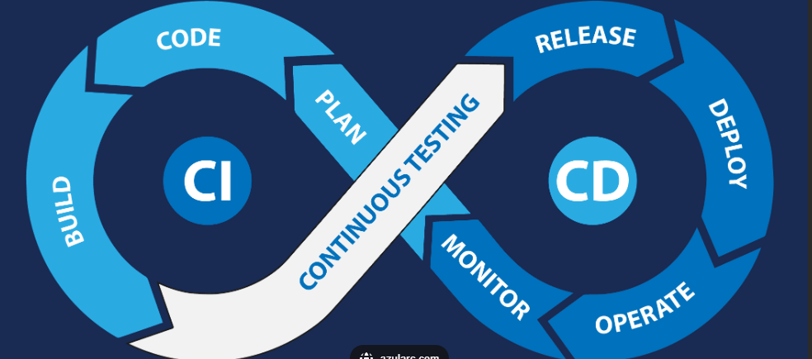


evOps
This project revolves around a pipeline to automate a sample application's build, testing, and deployment.
It Utilizes Jenkins for continuous integration, Docker for containerization, and Ansible for configuration management. It Implements automated testing and deployment to a cloud
Project Overview

Slide 3



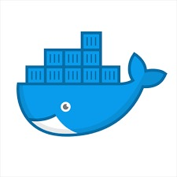



evOps
Content
01
02
03
04
05
CONFIGURATION MANAGEMENT
JENKINS PIPELINE
DOCKER-COMPOSE
INFRASTRUCTURE
MONITORING

Slide 4



evOps
Goals and objectives
Implement Infrastructure as Code and Containerization
Enhance Monitoring and Configuration Management
Automate the CI/CD Pipeline
Use Terraform for provisioning infrastructure and Docker for containerizing applications, ensuring consistency and scalability across environments
Utilize Ansible for automating configurations and Prometheus for monitoring system health, ensuring proactive issue detection and reliable deployments.
Leverage Jenkins to automate the build, test, and deployment processes, reducing manual intervention and improving release speed.

Slide 5
evOps
Project Flow
We developed a CI/CD pipeline for a sample web application, where the pipeline is linked to a GitHub repository.
The pipeline is automatically triggered upon any code push, ensuring continuous integration and deployment.
01.
Infrastructure
04.
Deployment:
Using Terraform, we provisioned two servers:
One server dedicated to running Jenkins as a Docker container.
A second server for deploying the web application.
The pipeline builds a JAR file from the application’s source code. A Docker image is created and pushed to Docker Hub. The web application is deployed on the application server using a Docker Compose file.
02.
ConfigurationManagement:
We utilized Ansible to configure and manage both servers.
05.
Notifications:
The pipeline is configured to send build result notifications to both Gmail and Slack, keeping the team updated on build success or failure.
03.
Pipeline Workflow:
The pipeline builds a JAR file from the application’s source code.
A Docker image is created and pushed to Docker Hub.
The web application is deployed on the application server using a Docker Compose file.
06.
Monitoring:
The server is configured with Prometheus to monitor system performance and application health.

Slide 6
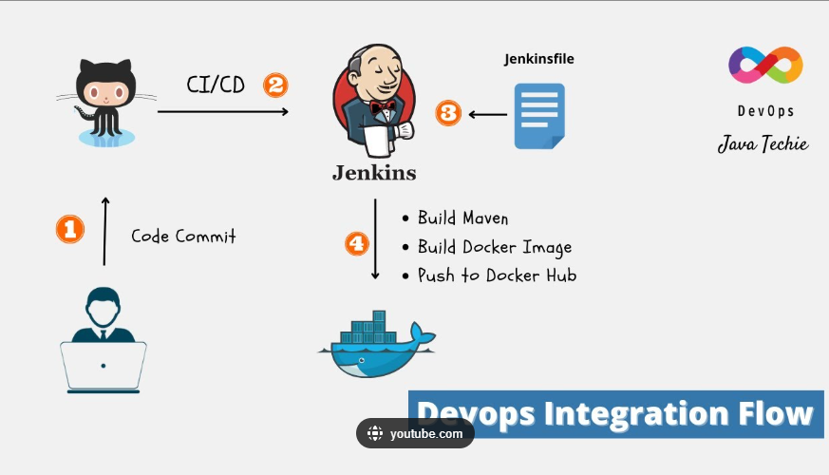

evOps

Slide 7





evOps
Infrastructure as Code (IaC)

Slide 8
evOps
Infrastructure as Code (IaC)
Project Context:
Key Tools:
We used Terraform to provision both the Jenkins server and the application server.
Terraform: Managed the deployment of servers in a scalable and repeatable manner.
VPC
Availability zone
IaC Benefits in our project:
Automated provisioning of infrastructure.
Ensured consistent environments across different stages of the pipeline.
Subnet
EC2
EC2
Jenkins-Server
Web-Server

Slide 9
evOps
Configuration Management

Slide 10
evOps
Configuration Management
Project Context:
Why Ansible?
We utilized Ansible for configuration management to:
Install dependencies on the Jenkins and app servers.
Ensure all systems have consistent configurations.
Automated the setup of environments and installation of necessary packages.
Easy to integrate into the CI/CD pipeline for repeatable configurations.

Slide 11
Configuration Management
Jenkins-Server
Docker
Ansible - Maven - Docker Client
Web-Server
Docker
Docker Compose

Slide 12
evOps
Jenkins Pipeline

Slide 13
evOps
Jenkins Pipeline
Project Pipeline:
Automated Workflow:
Build: Compile the project and generate the JAR file.
Build Docker Image: Package the app into a Docker image.
Push Docker Image: Push the Docker image to a Docker registry (Docker Hub).
Deploy: Deploy the app on the app server using Docker Compose.
Jenkins orchestrates the entire CI/CD process, from building to deploying.

Slide 14
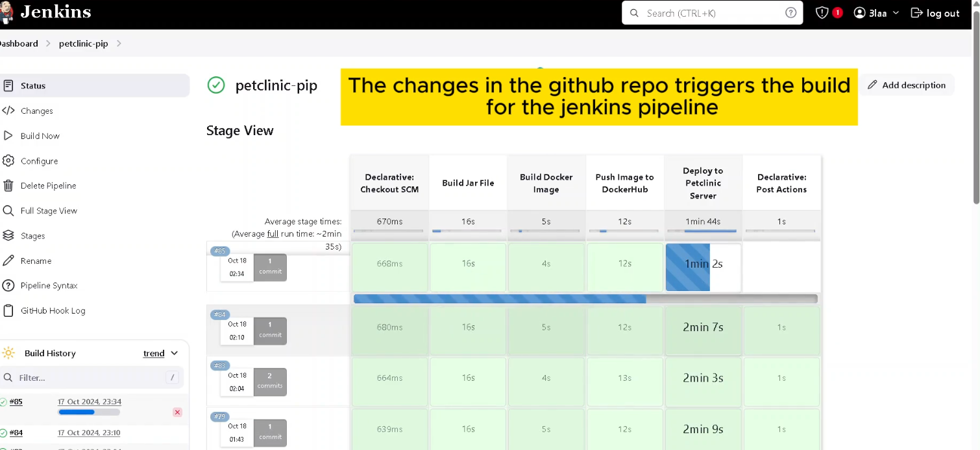
Jenkins Pipeline
evOps

Slide 15
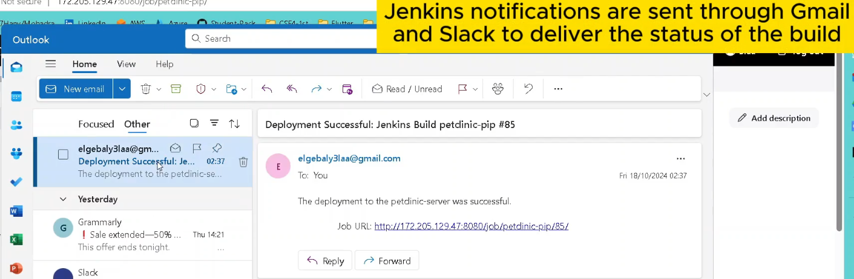

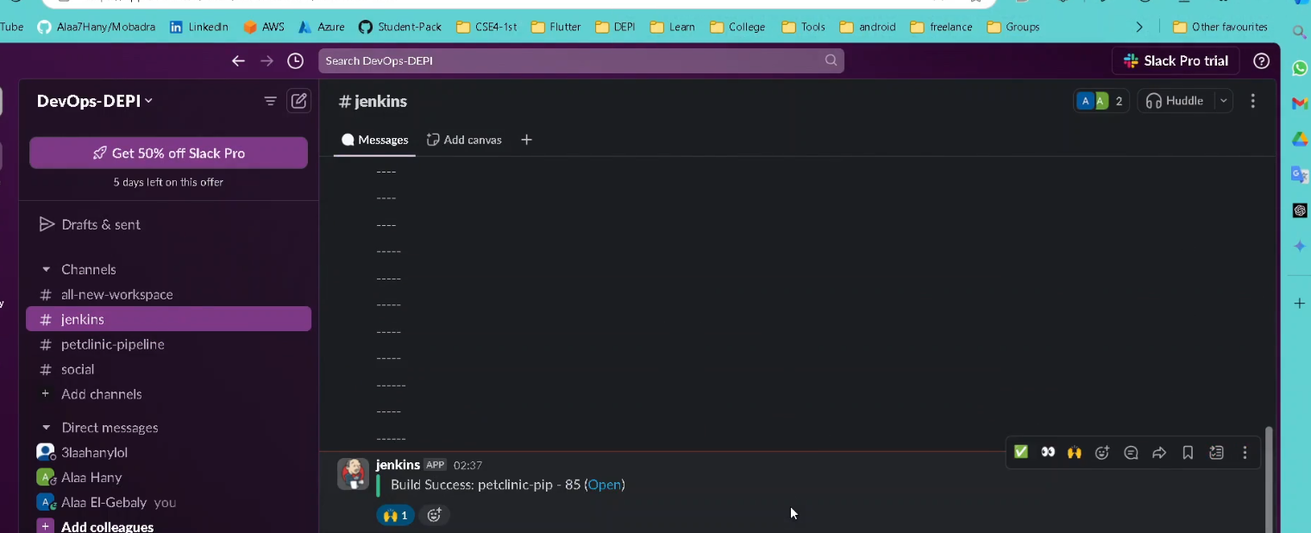
Jenkins Pipeline
evOps
Notification

Slide 16
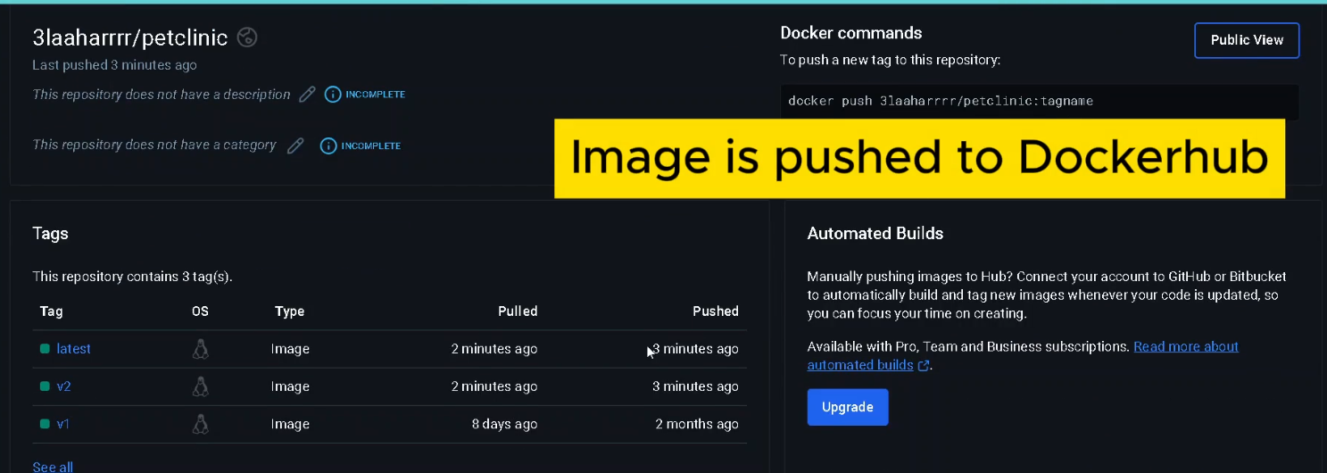
evOps
Jenkins Pipeline

Slide 17
evOps
Docker-Compose

Slide 18
evOps
Docker-Compose
Project Context:
Benefits
Docker Compose was used to orchestrate multiple containers on the app server:
The application container for PetClinic.
A MySQL database container to store app data.
A Nginx load balancer to distribute traffic between containers.
Simplified deployment with one command to launch all services.
Streamlined integration with Jenkins pipeline for seamless deployments.

Slide 19
Docker-Compose
evOps
PetClinic
MySQL
1
2
3
Request
4
5
Nginx load balancer

Slide 20
evOps
Monitoring

Slide 21
evOps
Monitoring
Project Context:
Benefits
Prometheus is set up on the app server to monitor the health and performance of the deployed services.
Real-time monitoring and alerting via Slack, helping to detect issues before they affect users.
Key Metrics Tracked:
CPU, memory usage, application response times, and container health.

Slide 22
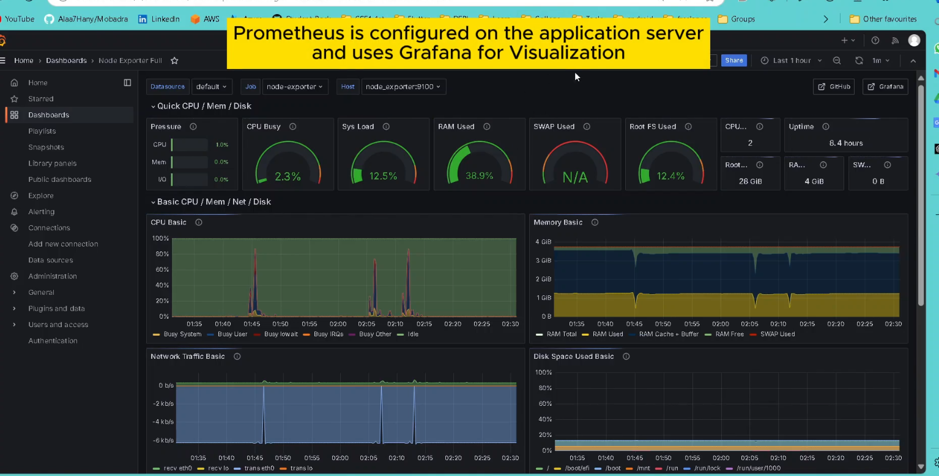
Monitoring
evOps

Slide 23

evOps
Team
We are students enrolled in the Digital Egypt Pioneers Initiative (DEPI), pursuing the DevOps track.
Throughout this journey, we have focused on mastering key DevOps methodologies such as continuous integration, automation, containerization, and infrastructure as code.
In this project, we applied the skills and knowledge we gained from DEPI, working to create an efficient and functional CI/CD pipeline.

Slide 24





Team
evOps
Mohamed Abdelhamed
Alaa El-Gebaly
Rashad Ahmed
CEO & Founder

Slide 25


Thank you

